Slide 1

Greek program of free education
Bachelor’s degree

Slide 2
About Program
We are glad to offer you more than 600 faculties at 35 Greek Universities and Institutions to study for free.
The benefits of studying in Greece start from the first stage - university entrance:
- need only high school certificate,
- without knowing greek language,
- without entrance exams,
- without the presence of the applicant.

Slide 3
About Program
You can choose 20 faculties from one of 4 directions:
Scientific direction of economics and management
Scientific direction of the humanities, law and social sciences
Scientific section of health sciences
Scientific section of technological sciences
And we guarantee that you will become the student of one of it.

Slide 4
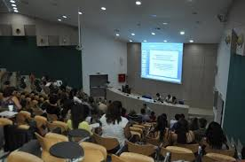
About Program
During the course of study (4 years - bachelor, 2 years - master) - there is no payment for tuition.
And students are supported by Greek Government:
the possibility of free accommodation in a hostel,
free food,
free provision of educational and methodological literature in the main faculties,
free visit to museums, historical monuments,
right to formal employment at around 4:00 a day,
student exchange programs and internship opportunities in other European countries.

Slide 5
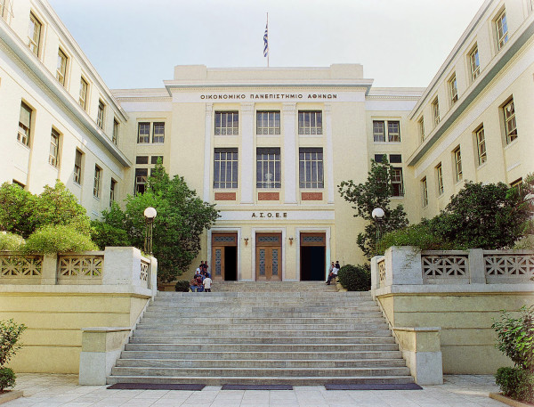
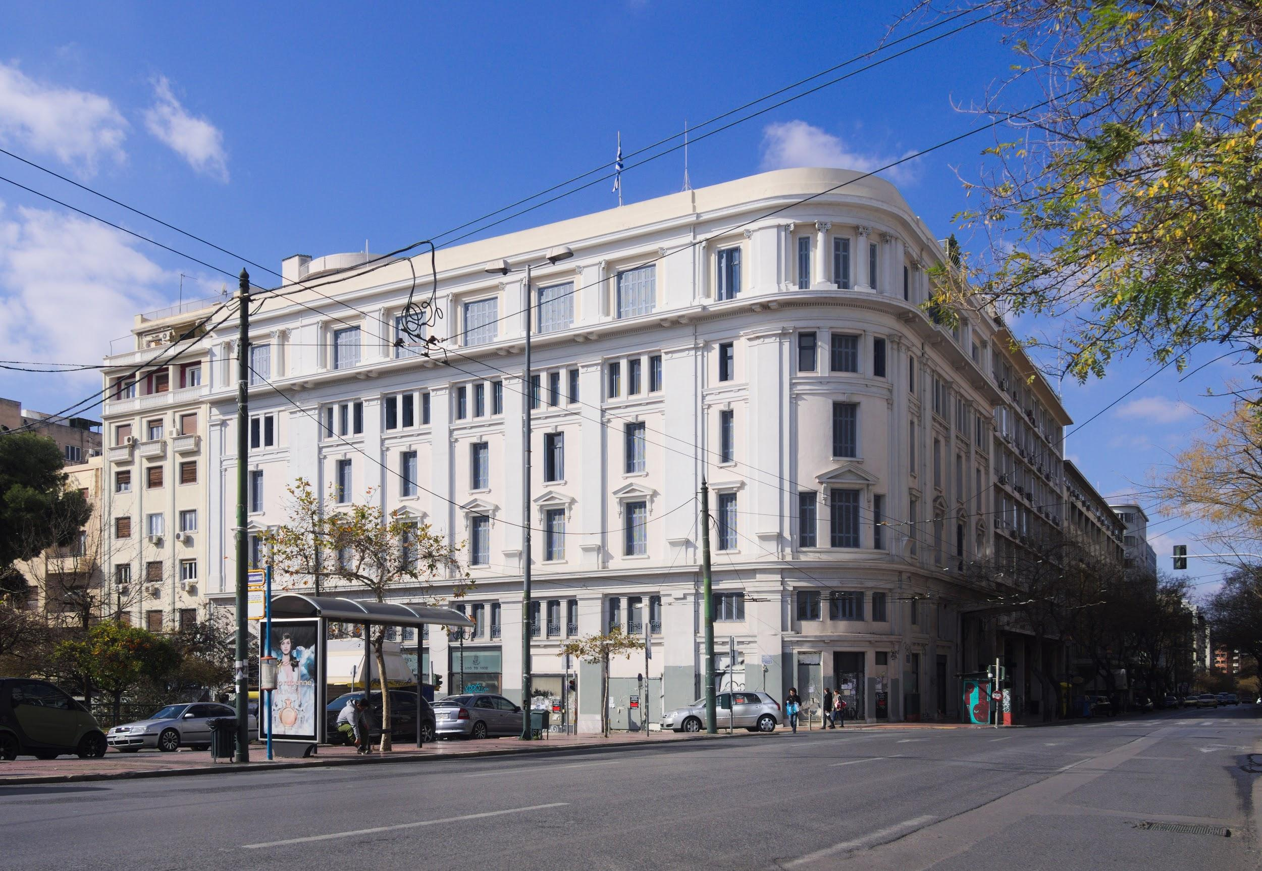
Universities
National and Kapodistrian University of Athens
Aristotle University of Thessaloniki
Ionian University
University of Macedonia
Democritus University of Thrace
Panteion University of Social and Political Sciences
University of Patras
University of Piraeus
University of Thessaly
University of the Aegean
University of Peloponnese

Slide 6
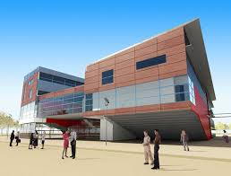
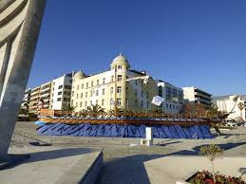
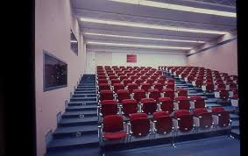
Universities
Athens School of Fine Arts
University of Crete
University of Ioannina
University of West Attica
University of Western Macedonia
Agricultural University of Athens
Harokopio University of Athens
Athens University of Economics and Business
Technical University of Crete
National Technical University of Athens

Slide 7
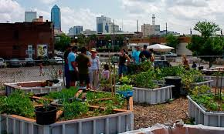
Technological educational institutes
Alexander Technological Educational Institute of Thessaloniki
Technological Educational Institute of Epirus
Technological Educational Institute of Crete
Technological Educational Institute of Western Greece
Technological Educational Institute of the Ionian Islands
Technological Educational Institute of Western Macedonia
Technological Educational Institute of Eastern Macedonia and Thrace
Technological Educational Institute of Thessaly
Technological Educational Institute of Central Greece
Technological Educational Institute of Peloponnese
Technological Educational Institute of Central Macedonia

Slide 8
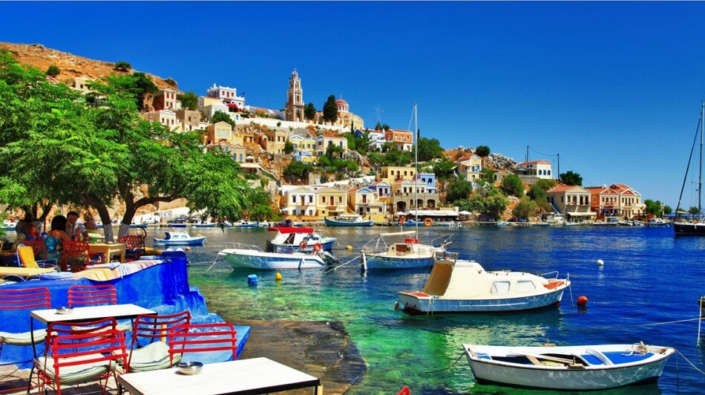
Academies and schools
Rodos Advanced School of Tourism Education
School of Tourism Education of Agios Nikolaos
School of Pedagogical and Technological Education

Slide 9
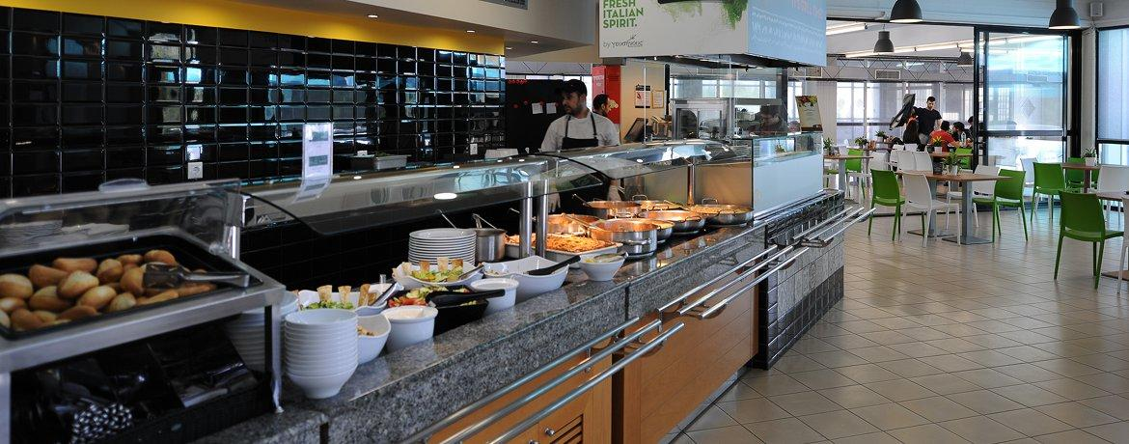
Fee structure
First year ( studying greek modern language):
Residence permit (state duties, medical insurance) 500 euros
Courses of modern Greek language ( 8 month) 985 euros
Apartment 300-350 eur/month
Meals in univ. canteen 100 euros / month
Food and personal expenses 200-.. euros/month
Company’s Fee 2500 euros
But while studying language - you are already a student of one of the faculties.
And from the first course of university you have all free - food at university canteen, dormitory, books, courses.

Slide 10
Documents
Application form with photo
Student’s foreign passport
Higher School Certificate
Annex to the Higher School Certificate
Color photographs (3.5*4.5 size)
paper carrier + electronic version
Certificate from school issued by Ministry of Education:
Medical Certificate for admission to the university
Notarized power of attorney, issued to the authorized representative for submission of the Prospective Student’s documents to the Ministry of Education of Greece
Deadline 1st of July

Slide 11
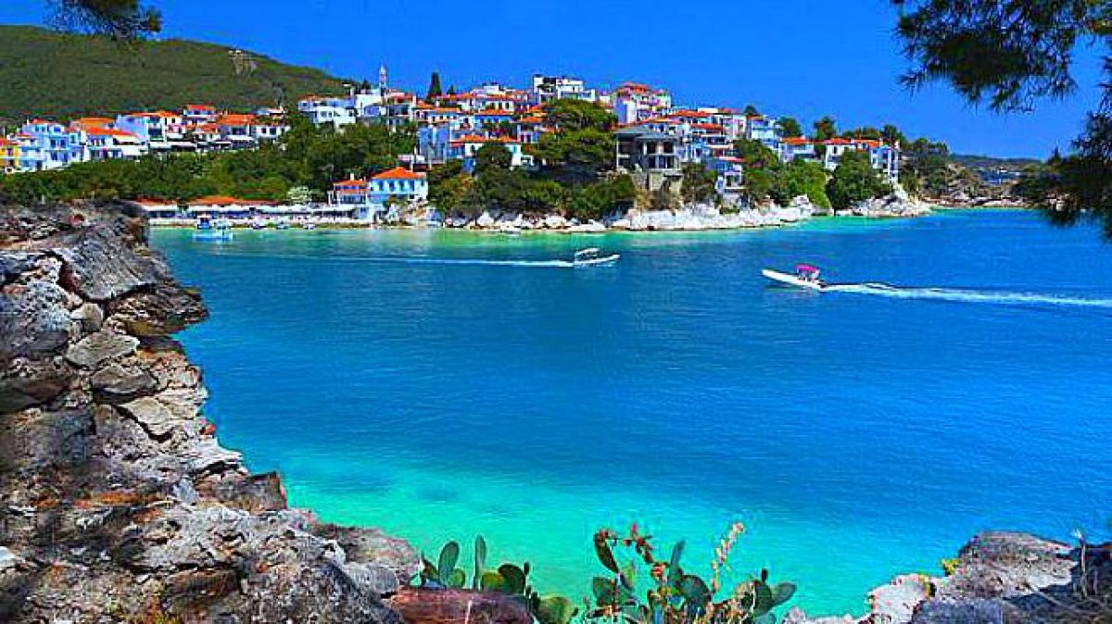
We will be glad to see you among students in Greece

